Slide 1
Central E-Birth Registration and Certificate Issuing System
PREPARED BY: ZAINAB OLUWATOSIN OYELEKE (CST20HND0630)
SUPERVISED BY: MR. SHAMSUDDEEN MUSA AHMAD

Slide 2
Table of Content
Background of the Study
Statement of the Problem
Aims and Objective of the Study
Significance of the Study
Summary of Literature Review
Research Methodology
System Modeling
Proposed Interface Design
Summary / Conclusion

Slide 3


Background of Study
Birth Registration is a fundamental right of all children and a basic function of all modern governments. Although birth registration is almost complete in all developed countries, the lack of progress on civil registration in many developing countries means that global inequalities in birth registration are now extreme. The conventional method of birth registration is by human inspection. Manual birth registration is complex and impractical for a large increase in population. The cost of registering a child, loss of registration certificate by the parent and child, and inaccurate population statistics are possible problems that inaccurate birth registration records can cause. Birth registration became an issue of utmost importance as a result of difficulties encountered while obtaining accurate population statistics essential in social services planning for any government and in ensuring that adequate resources and budgets are made available to address the needs of the populace. The use of a globally accessible device for birth registration has shown great potential in this field

Slide 4
Statement of the Problem
The manual method of birth registration is by human inspection which is prone to so many errors. The cost of registering a child, loss of registration certificate by the parent and child, and inaccurate population statistics are possible problems that inaccurate birth registration records can cause. The use of the globally accessible device for birth registration has shown great potential in this field. The performance of the Online National Database for Birth Registration was evaluated in terms of accessibility, speed, cost, and capacity; and the result confirmed that the proposed central e-Birth registration and certificate issuing system will be able to assist government officials in terms of having a globally accessible system, speeding up the birth registration process, reducing the cost of registering a child and capable of keeping registration details for future use

Slide 5

Aim and Objectives of the Study
Aim
Objectives
The research work aims to develop a Central E-Birth Registration and Certificate Issuing System
Develop a system for easy registration of Birth Certificates and to enable printing of the hard copy of the Birth Certificate.
Design a user-friendly application that can easily verify certificates without wasting much time going to the place for Birth Certification.
Develop the application using HTML, CSS, JavaScript, and Django (Python.

Slide 6
Significance of the Study
The main importance of this study is that it helps in the provision of an easy way of registering and obtaining Birth Certificates anywhere and at any time

Slide 7
Summary of literature review
Title | Author & Year | Description | Merit | Demerits
Web Base Online Birth Registration and Certification System | Khandagale, et al. (2022) | The system provides a simple method to register and acquire a birth certificate from anywhere and at any time | This initiative would also provide funds for national planning | The system is a privilege for children whose parents are educated and elite.
An Electronic Birth Record Management System for Nigeria | Oliha et al. (2019). | This paper developed an electronic birth registration system to manage birth records throughout many registration centers in Nigeria | Any birth information can be checked to checkmate falsification irrespective of its registration center. | The proposed system is yet to be deployed.
Design and Implementation of an Online National Database for Birth and Death Registration | Oshomoh (2017). | The system tends to provide solutions to present challenges in birth and death registration, promoting a more effective and efficient data gathering, storage, processing, and retrieval approach | Data consistency and data security were achieved. | Deep technical know-how is needed to operate the system.

Slide 8
Summary of literature review
Title | Author & Year | Description | Merit | Demerits
E-birth Registration and Certificate Issuance System. | Ojokoh and Afolayan. (2017). | This study presents a web-based birth registration and certificate issuing platform that will aid government authorities in terms of speeding up the child-birth registration procedure, lowering the cost of registering a kid, and storing registration records for future use. | The system aided in keeping track of the nation's population in terms of gender, children, and adults. | The system might possess security issues as was suggested for future research.
Online Birth Registration & Certification System. | Sonali (2021). | The proposed web-based birth certificate system results in an easily and internationally accessible system, which speeds up the birth certificate issuance procedure. | The system minimized paperwork for birth applications. | An Internet connection is a must. Lack of network can create problems
Development of a Web Application for Birth and Death Certificate Request. | Pelumi (2016). | The project is intended to create a website where citizens can request birth and death certificates. | The system provided improved efficiency in obtaining certificates in a digital format. | The system was not deployed to maximize its efficiency.

Slide 9

Research methodology
Choice of programming language
Method of data collection
This research project will be a web-based application built on a relational database architecture (SQLite). For frontend development, HTML (hypertext markup language), CSS (cascading style sheet), and JavaScript will be used, while Django (Python) will be used for backend programming
Before developing any system, collecting data and facts about the existing system is critical to understand what is going on. This research was carried out using two methods.
Observation of the Work Environment
Documentation.

Slide 10
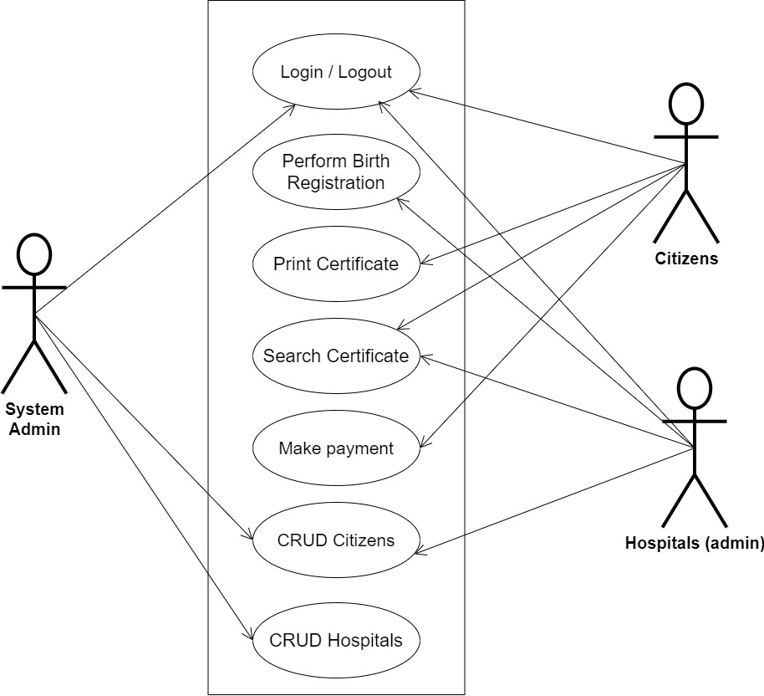
SYSTEM MODELING (USE CASE DIAGRAM)

Slide 11
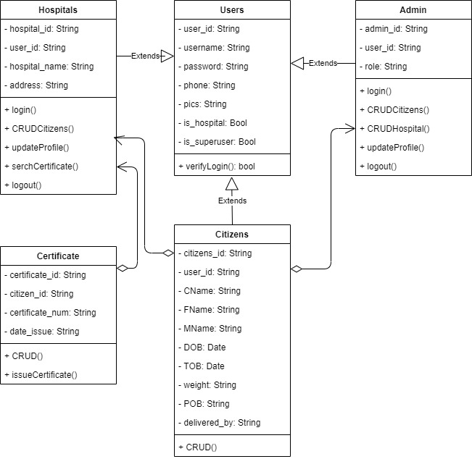
SYSTEM MODELING (CLASS DIAGRAM)

Slide 12
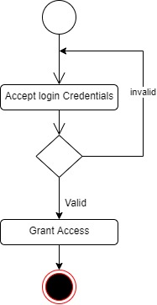
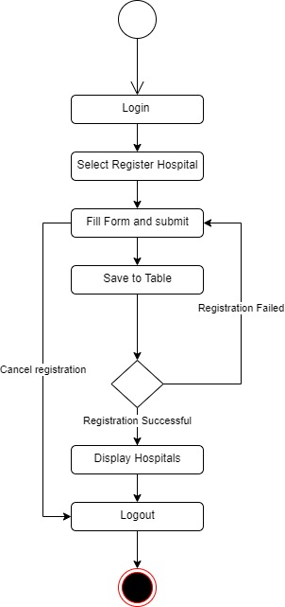
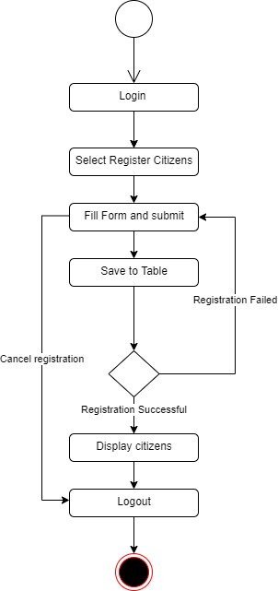
SYSTEM MODELING (ACTIVITY DIAGRAM)
User Login Activity
Register Hospital Activity
Register Citizen Activity

Slide 13
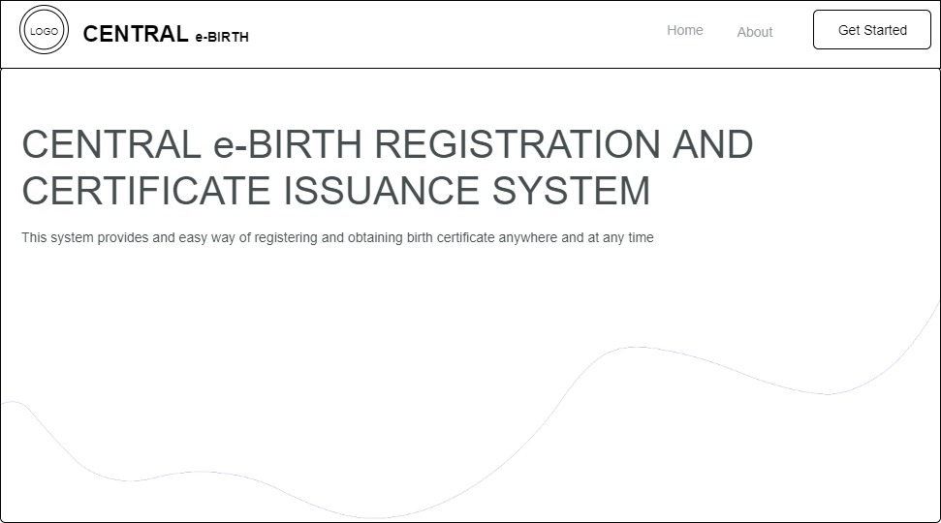
PROPOSED INTERFACE DESIGN
Homepage

Slide 14
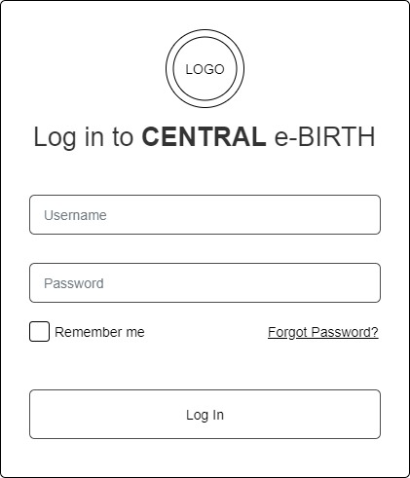
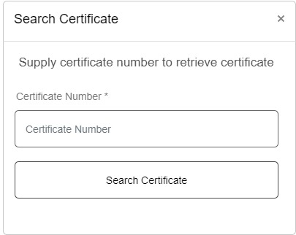
PROPOSED INTERFACE DESIGN
Login Form
Search Certificate Form

Slide 15

Summary
This research work focuses on the development of a Central e-Birth Registration and Certificate Issuing System, for newly born babies. The system will not cover the registration of adults, the thesis does not go beyond this.
In conclusion, this study's scope has been constrained by several issues, including that the system will be only on a local host as the web application is designed for an undergraduate program

Slide 16

Thank you

